Slide 1
Inventory Management

Slide 2
Team Members
S No | Name | Roll Number | Section
1 | Sopinti Rithvik | 2310030081 | A3
2 | K Sai Shreyas | 2310030085 | A3
3 | G Krishanth Reddy | 2310030178 | A3
4 | J Teja | 2310030388 | A3

Slide 3
Problem Statement
Manual inventory processes lead to inefficiencies and inaccuracies. The goal is to create an Inventory Management Application to automate inventory tasks, reduce errors, and provide real-time stock tracking.

Slide 4
Core Features
Product Management: Add, edit, delete product details.
Inventory Tracking: View stock levels and search products.
Order Management: Track purchase orders and suppliers.
Sales Tracking: Record sales and update inventory.
Restocking Alerts: Notify for low stock levels.
User Authentication: Role-based access (admin/staff).

Slide 5
Requirements
Software Requirements
Frontend: Java Swing
Backend: Java
Database: NoSQL
IDE: IntelliJ IDEA
System Requirements
OS: Windows/macOS
RAM: 4 GB+
Processor: Core i3+
Java: JDK 8+

Slide 6
Workflow of the application
Login:
Users log into the system.
Home Screen:
Access a summary of inventory stats (e.g., stock levels, alerts).
Manage Products:
Add or update product information and stock.
Record Transactions:
Log sales and purchase data to update inventory automatically.
View Reports:
Generate and export reports on inventory or sales performance.

Slide 7
Module 1: User Management
Manages authentication and authorization for Admin, Supplier, and Inventory Manager
Features: Login, Registration, Role-based Access

Slide 8
Module 2: Inventory Management
Maintains stock details, item categories, and product availability
Tracks stock levels, reorder points, and expiration

Slide 9
Module 3: Order Management
Manages purchase orders from suppliers and customer orders
Tracks order status, shipment, and delivery

Slide 10
Module 4: Reporting & Analytics
Generates reports on stock movement, sales, and supplier performance
Provides real-time insights for decision-making

Slide 11
Module 5: Notifications & Alerts
Alerts for low stock, order status updates, and supplier communication

Slide 12
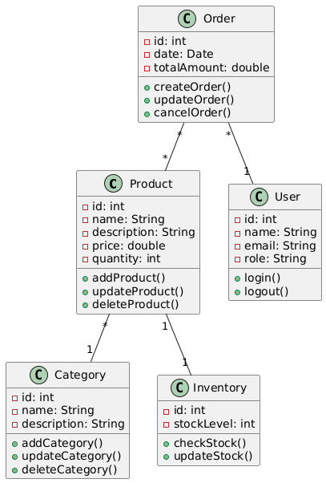
Class Diagram

Slide 13
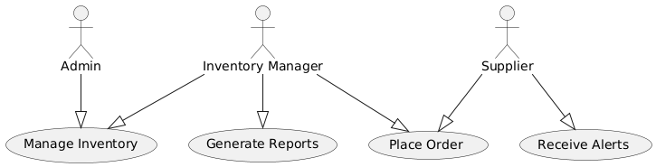
Use Case Diagram

Slide 14
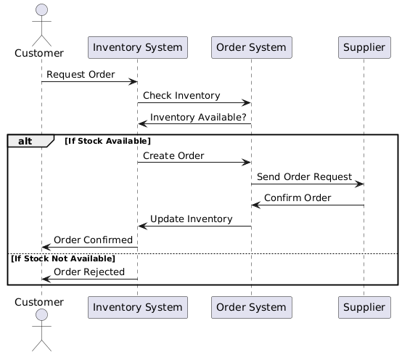
Interaction Diagram

Slide 15
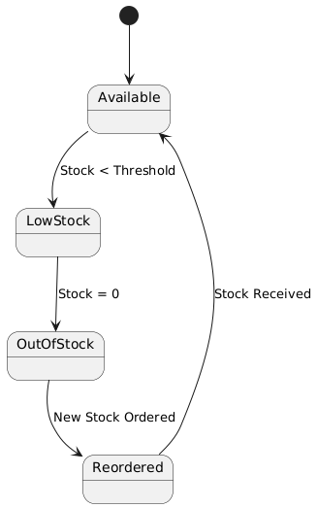
State Chart Diagram

Slide 16
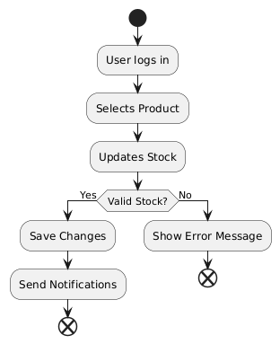
Activity Diagram

Slide 17
Thank you

